Slide 1
How to Access Castle LEarning

Slide 2
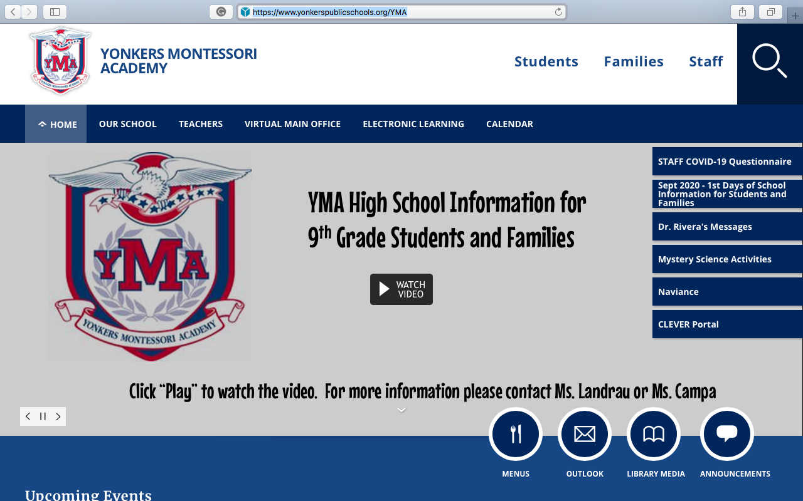
Step one
Go to the Yonkers Montessori Webpage (https://www.yonkerspublicschools.org/YMA)
Once on the page, locate Clever Portal on the right side of a page and press/click on on Clever Portal.

Slide 3
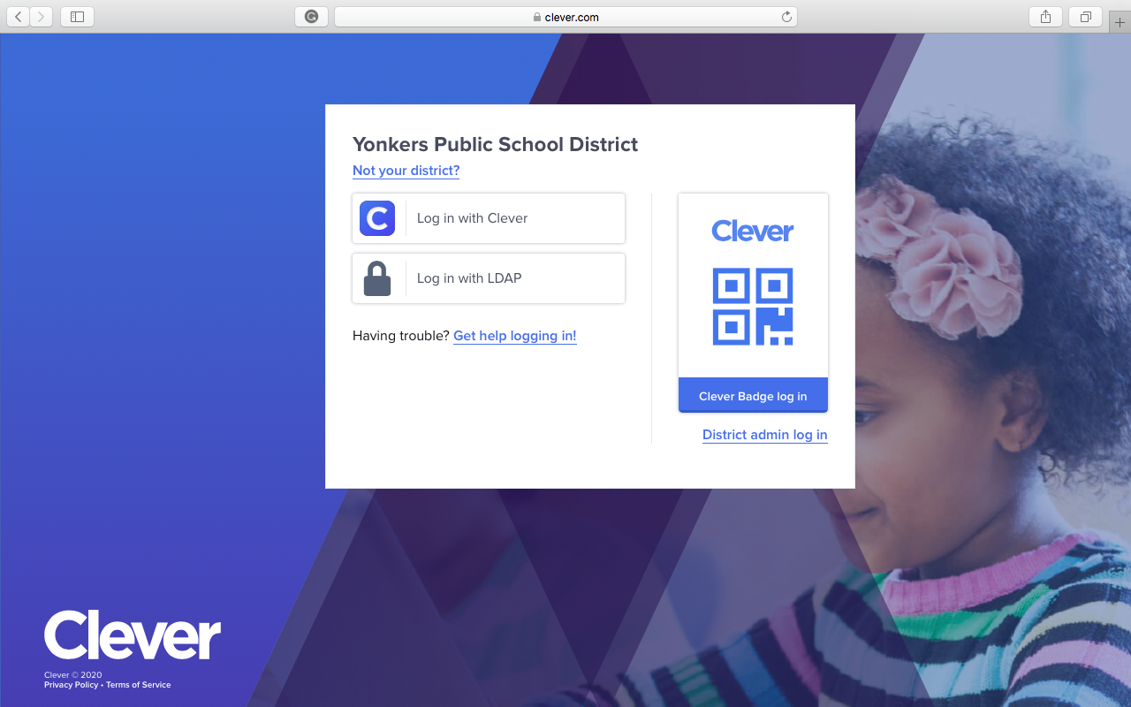
Step two
After pressing/clicking on Clever Portal a new page will open.
Press/click on the LOG IN WITH LDAP.

Slide 4
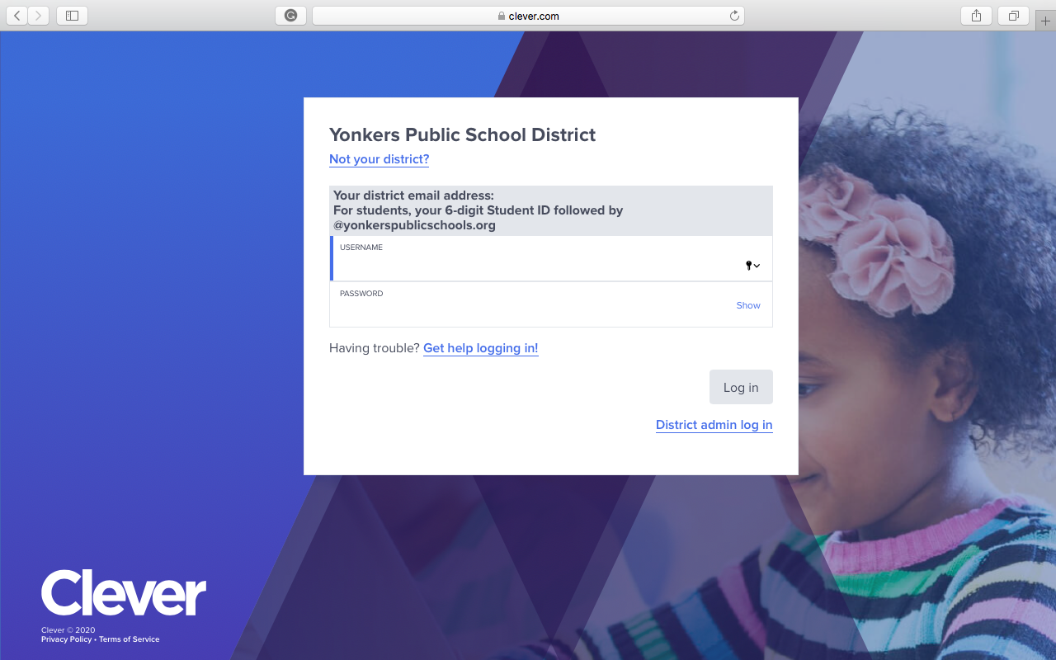
Step Three
After pressing/clicking on Log in with LDAP a new page will open.
You now will enter your username and password.
Username is your district email. It is your 6 digit Student ID followed by @Yonkerspublicschools.org (ex: 123456@Yonkerspublicschools)
Your password is your date of birth (ex: 12231990)

Slide 5
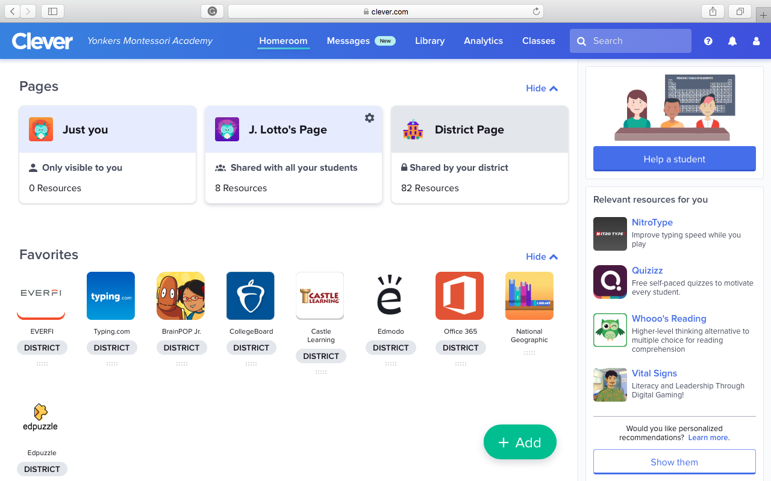
Step Four
After logging in your page should look like the image on the right.
From this page you can access all the web based products Yonkers Public school has purchased.

Slide 6
Step 5
Once on this page, go to my name J. Lotto.

Slide 7
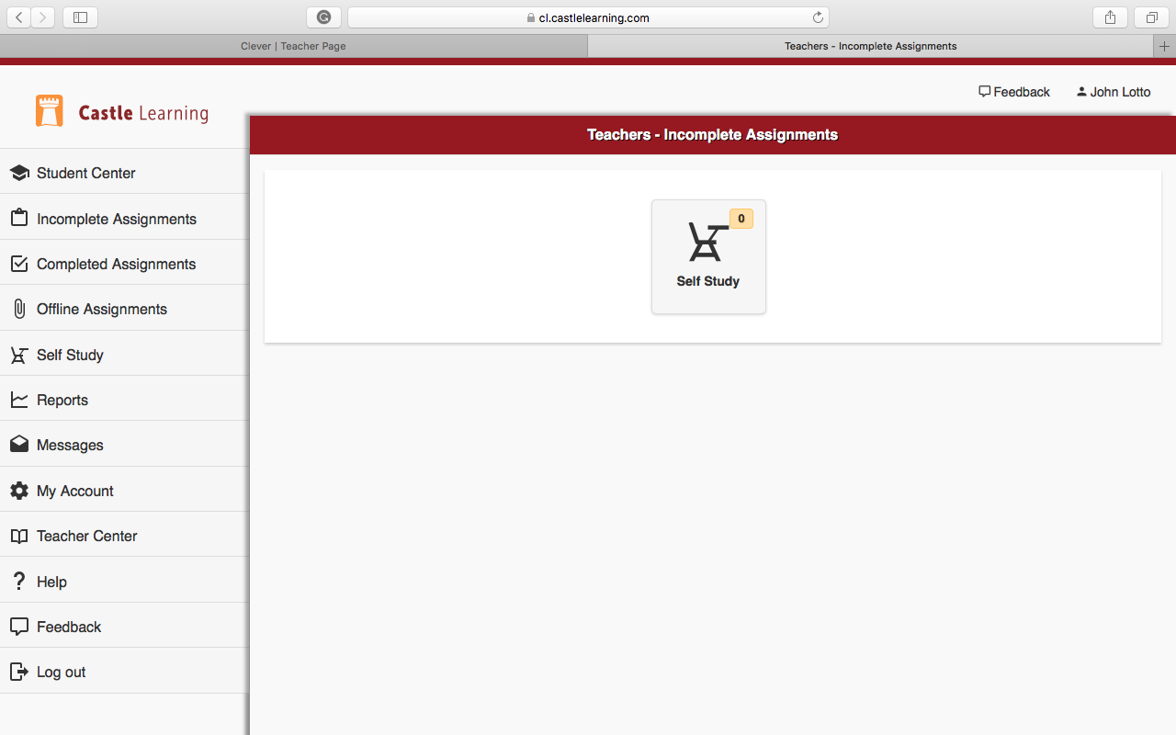
Step 6
Once you press/click on my name, a new page will open.
From here you can locate all your assignments in the incomplete assignment channel on the left side of the page

